Slide 1
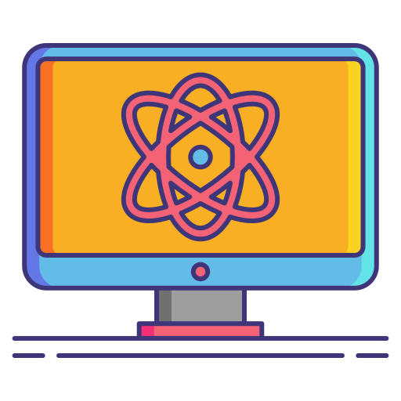
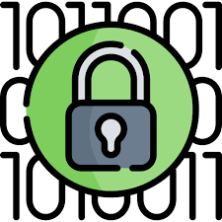
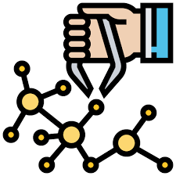
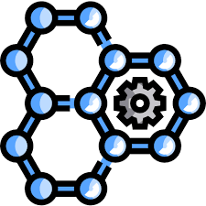
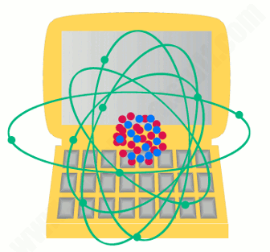

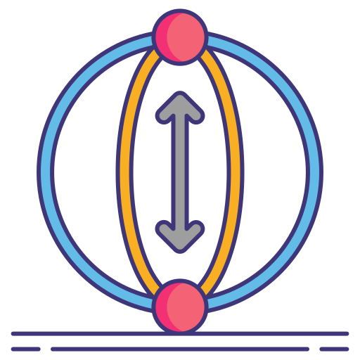

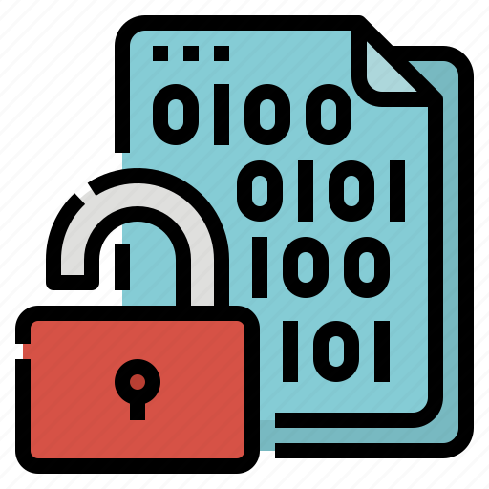

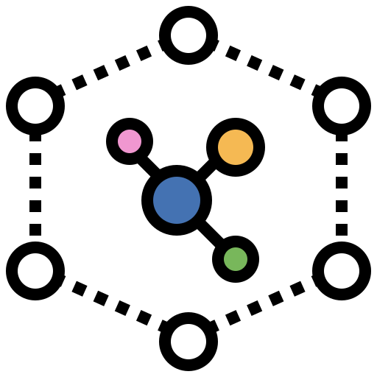
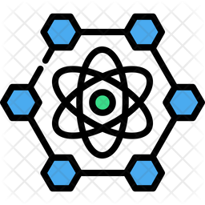
Can you decrypt all the encrypted data using nanotechnology in a matter of minutes?

Slide 2



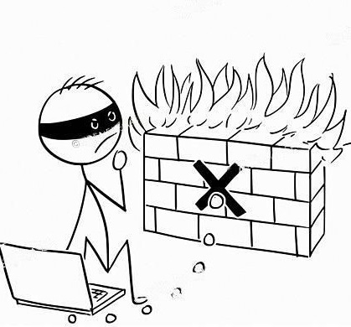

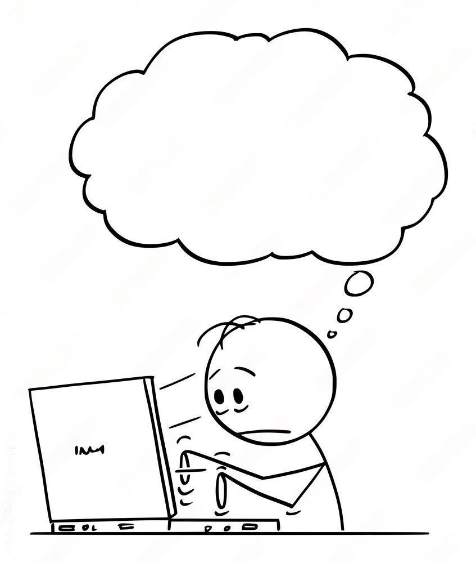



Slide 3
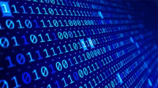

Slide 4



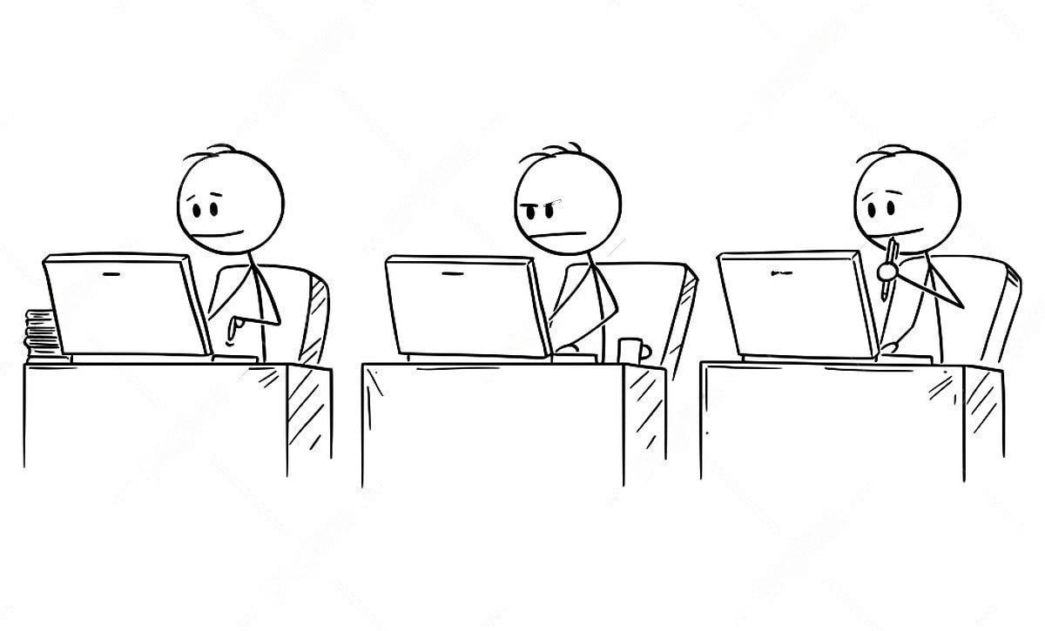

?
?
N = __ x __
HARD

Slide 5
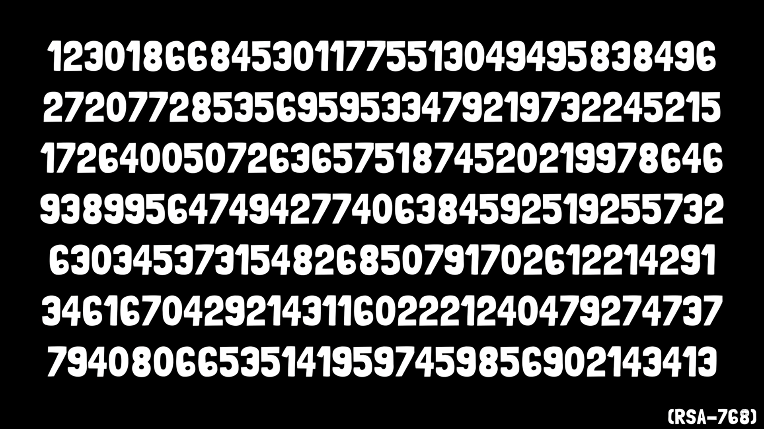

Slide 6

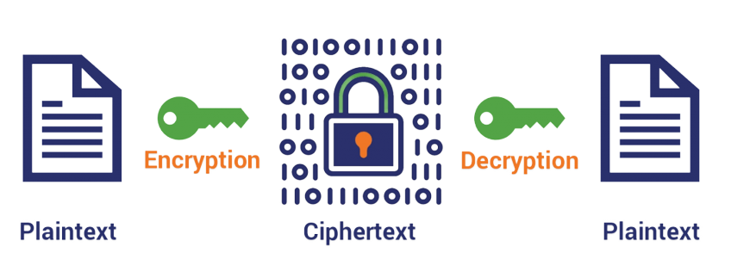

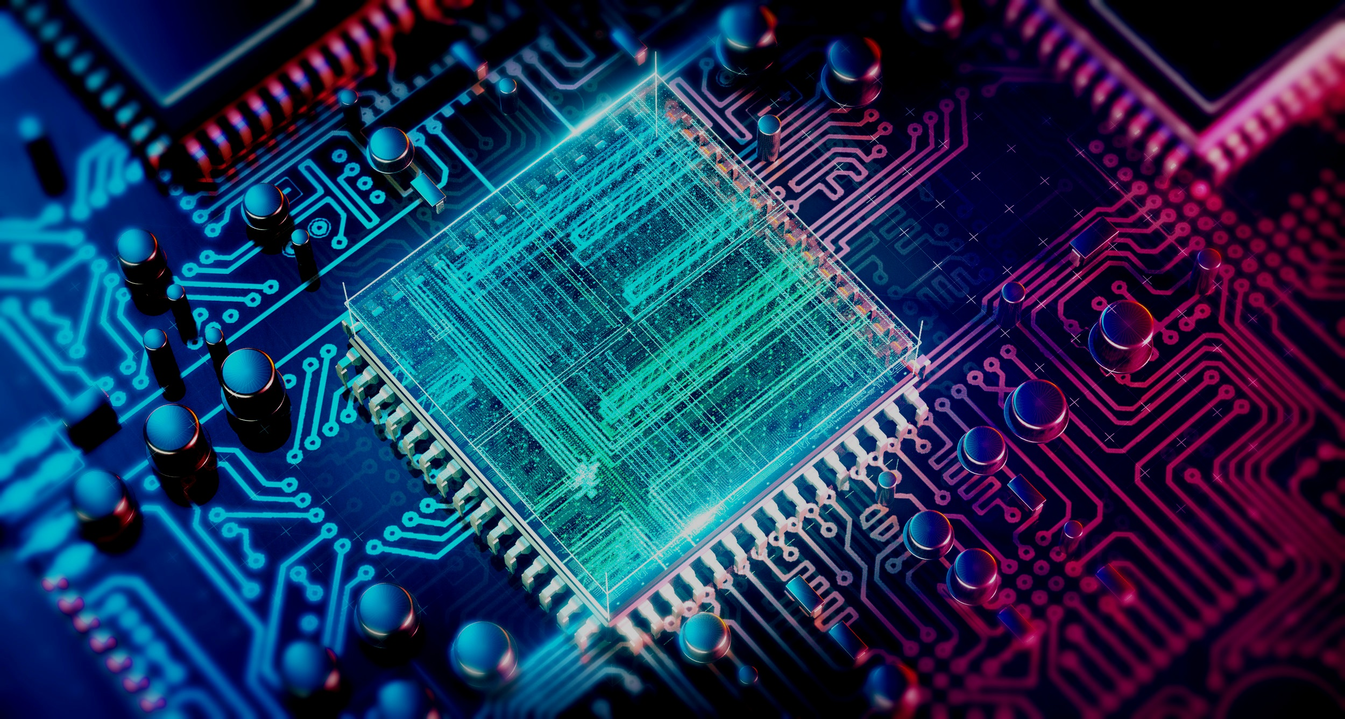
Is it possible to encrypt this data faster
Yes, by making a computer with a billion CPU’S or maybe just one Quantum Computer using nanotechnology. Due to recent developments in the field of nanotechnology, quantum computers are now in an advanced stage of development.
Any digital system that uses existing public standards for public-key cryptography, or that is planning to transition to such cryptography, could be vulnerable to an attack by a quantum computer.

Slide 7


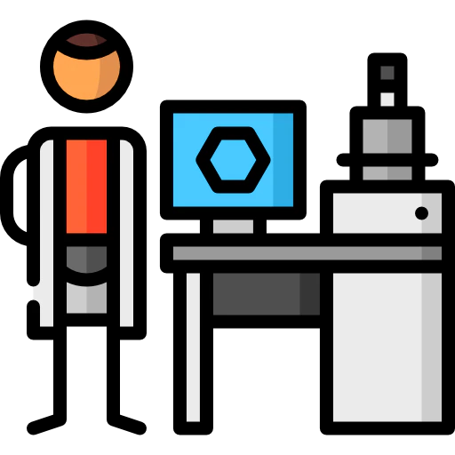


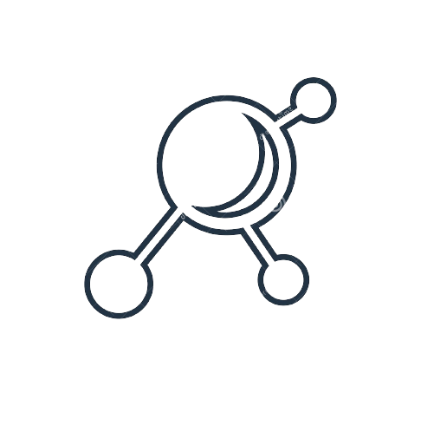

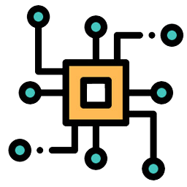

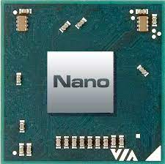
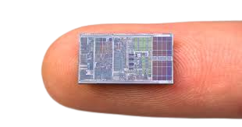
Nanotechnology in Computer Science
Nanotechnology is now a days strengthening its roots in the field of computer science by contributing in the creation of more efficient computing components.
Today a computer can be carried with one hand –40 years ago a computer (hundreds of times slower) was the size of a room. Miniaturization of microprocessors is currently in process at nan metre-scales.

Slide 8
BITS
0 and 1

Slide 9
Example: 3 BITS
000
001
011
010
110
101
100
100

Slide 10
QUANTUM BITS
0
0
1
1
(QUBITS)

Slide 11
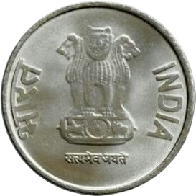
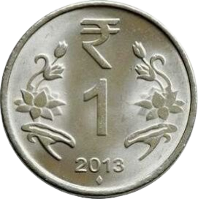
HEADS
TAILS
1
0

Slide 12
HEADS
TAILS

Slide 13
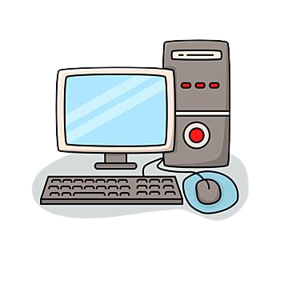
Example: 3 BITS
000
001
011
010
110
101
100
111

Slide 14



Example: 3 BITS
000
001
011
010
110
101
100
111

Slide 15


QUANTUM COMPUTERS
QUANTUM BITS
111
000

Slide 16
QUANTUM COMPUTERS
QUANTUM BITS
100
111
100
000

Slide 17
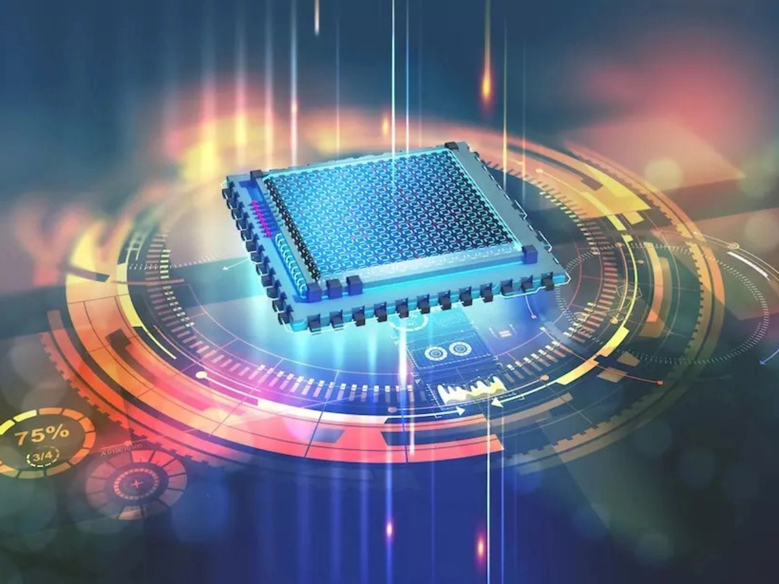

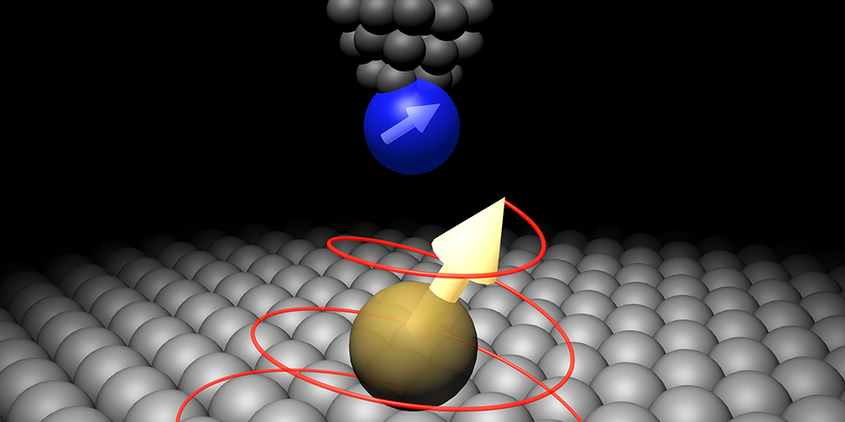
Nanotechnology in Qubits
Nanotechnology has opened wide new avenues for exploring and harnessing quantum mechanical effects in condensed matter. These quantum phenomena, in turn, have the potential to revolutionize the way we communicate, compute and probe the nanoscale world. Here, we review developments in key areas of quantum research in light of the nanotechnologies that enable them, with a view to what the future holds.
Qubits based on Quantum Dots clearly are nano-scale devices. Quantum computing holds the potential to store and manipulate data through the utilization of nanoparticles. The abilities that quantum computers hold surpass the ones held by conventional computers. Combining the present technology with the staggering potential of nanotechnology to forge devices from the smallest building blocks we are certainly on the verge of a revolution.

Slide 18
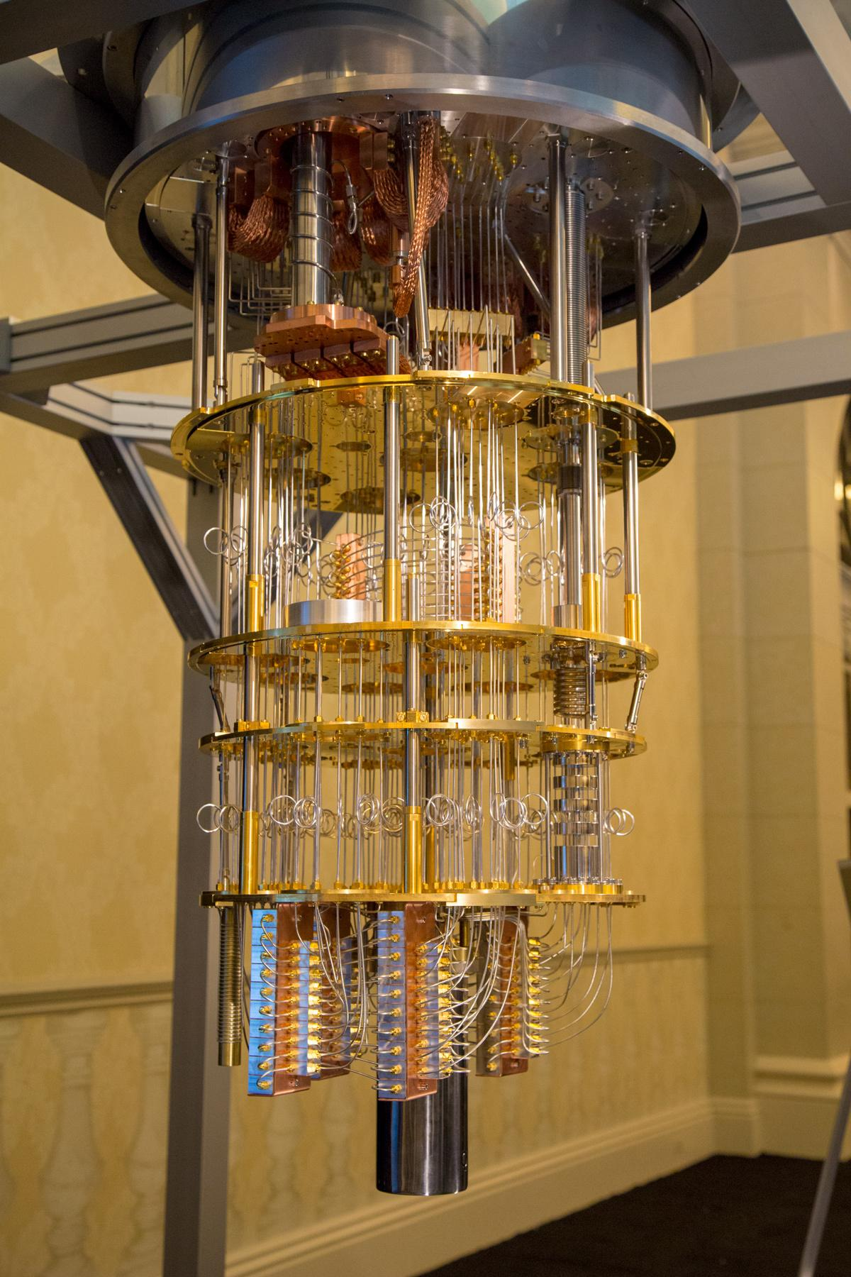
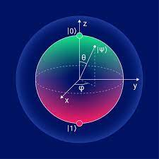
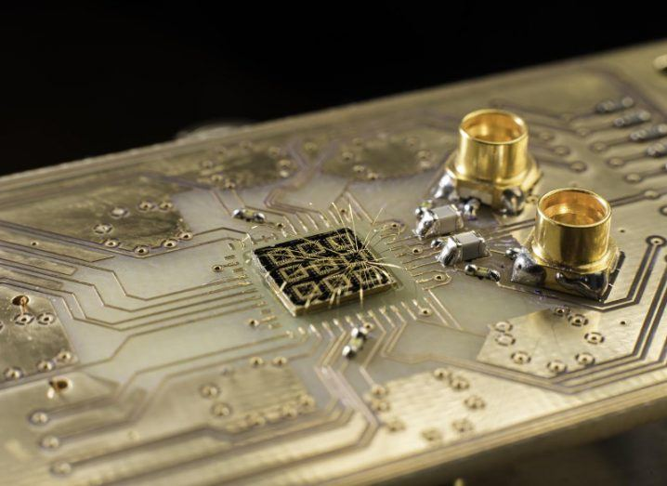
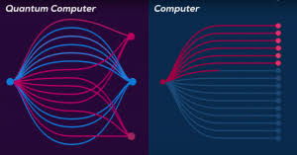
Why not yet?
Quantum computers are on the brink of maturity, and they’re so powerful that they can solve complex mathematical problems in minutes that would take thousands of years for classical computers.
Being governed by the laws of quantum mechanics and nanotechnology, quantum computers can now compute solutions to problems with greater speed whilst requiring less space.
These new machines would need to be able to deploy millions of qubits, to crack today’s passwords. Experts agree that it will take years, until quantum computing reaches that point.
But when done it is likely to change the way almost everything –from vaccines to computers to automobiles tyres to objects not yet imagined –is designed and made.

Slide 19

BIBLIOGRAPHY
https://www.ncbi.nlm.nih.gov/books/NBK538701/#:~:text=Building%20quantum%20computers%20is%20incredibly,deal%20with%20two%20competing%20requirements.
https://www.youtube.com/watch?v=frVnzTdxcL0&list=PL1p6ahX31DidHzBt2J02IPfVuuwe0G4gk&index=1
https://www.youtube.com/watch?v=-UlxHPIEVqA&list=PL1p6ahX31DidHzBt2J02IPfVuuwe0G4gk&index=2
https://www.youtube.com/watch?v=6X5ZYgvTh9k&list=PL1p6ahX31DidHzBt2J02IPfVuuwe0G4gk&index=3
https://www.youtube.com/watch?v=QuR969uMICM&list=PL1p6ahX31DidHzBt2J02IPfVuuwe0G4gk&index=4
https://www.youtube.com/watch?v=yy6TV9Dntlw&list=PL1p6ahX31DidHzBt2J02IPfVuuwe0G4gk&index=5
https://www.youtube.com/watch?v=X8MZWCGgIb8&list=PL1p6ahX31DidHzBt2J02IPfVuuwe0G4gk&index=6
https://www.youtube.com/watch?v=6eJVVCO6GRM&list=PL1p6ahX31DidHzBt2J02IPfVuuwe0G4gk&index=7
https://www.youtube.com/watch?v=JhHMJCUmq28&list=PL1p6ahX31DidHzBt2J02IPfVuuwe0G4gk&index=8
https://www.youtube.com/watch?v=lypnkNm0B4A&list=PL1p6ahX31DidHzBt2J02IPfVuuwe0G4gk&index=10

Slide 20


